Slide 1
FTI Consulting, Inc. Global Insurance Industry Services Materials Prepared for Discussion
Notes:
0

Slide 2
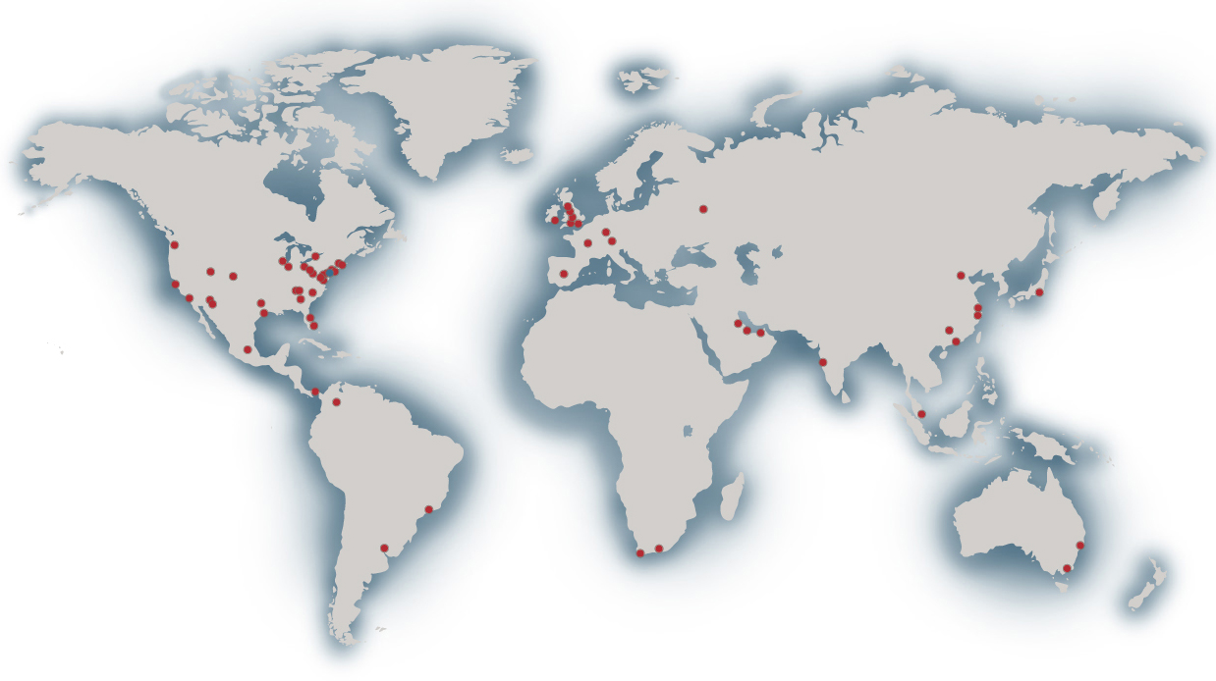
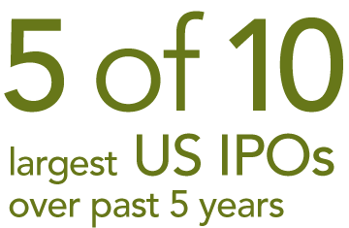
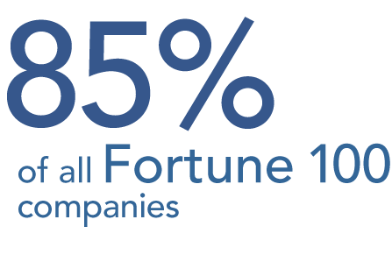
FTI CONSULTING INC CONFIDENTIAL ADVISORS ACROSS THE GLOBAL ECONOMY
United States
Annapolis
Atlanta
Baltimore
Bethesda
Boston
Brentwood
Cambridge
Charlotte
Chicago
Cleveland Dallas
Denver
Detroit
Houston
Indianapolis
King of Prussia
Los Angeles
Miami
Morristown
Nashville
New York
Oakland, NJ
Orlando
Orange County
Philadelphia
Phoenix
Pittsburgh
Rockville
Roseland
Saddle Brook
Salt Lake City
San Francisco Seattle
Tucson
Washington, DC
West Palm Beach
Argentina Buenos Aires
Australia Melbourne Perth
Sydney
Bahrain
Manama
Belgium Brussels
Brazil
São Paulo
Canada Toronto
Vancouver
China Beijing Guangzhou Hong Kong Shanghai
Colombia Bogotá
France Paris
Germany Frankfurt Munich
Ireland Dublin
India Mumbai
Japan Tokyo
Mexico Mexico City
Panamá Panamá City
Qatar
Doha
Russia Moscow
Singapore
South Africa Cape Town Johannesburg
Spain
Madrid
United Arab Emirates Abu Dubai
Dubai
United Kingdom Epsom London Manchester
Northampton Stirling
●
15 of 25
Largest Insurance
& Reinsurance
Companies
Notes:
Our prestigious clients are located across the globe. Our professionals are located in every major financial center in the world so that we can serve them wherever challenges arise.

Slide 3
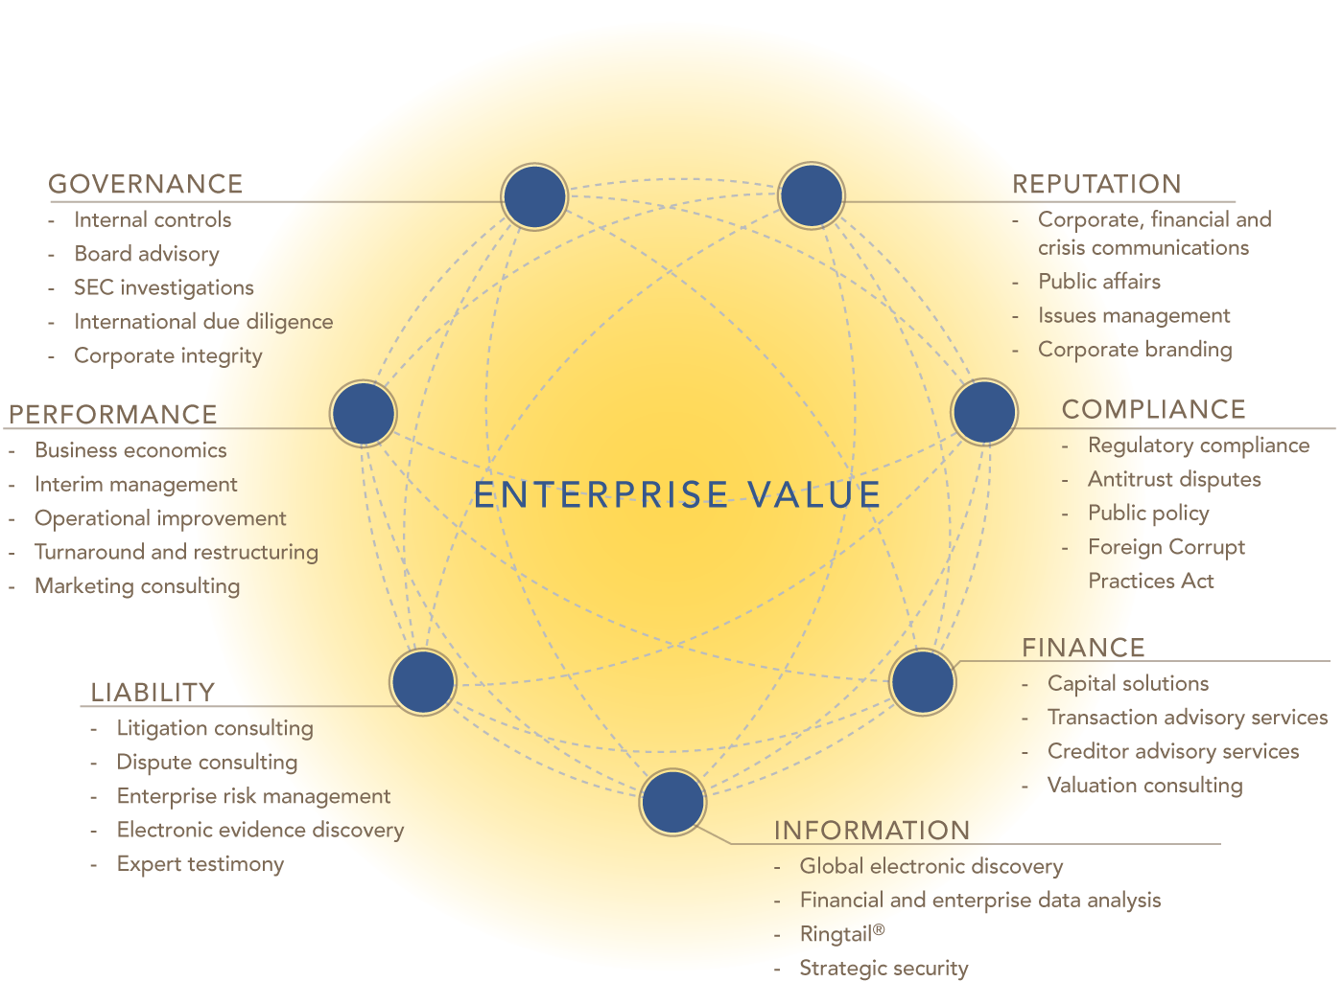
FTI CONSULTING, INC
GLOBAL INSURANCE INDUSTRY SERVICES
Drawing on the Global Resources of FTI to Deliver Critical Services…
Notes:
FTI is designed to address the key areas that can threaten a business’ valuation or reputation. No matter what the triggering event, it tends to evolve and can require a much broader set of skills and expertise. [examples] Our service model addresses the interrelated nature of these issues and their impact on enterprise value.

Slide 4
FTI CONSULTING, INC.
GLOBAL INSURANCE INDUSTRY SERVICES
Credentialed Experts…100s of Engagements…Every Aspect of Insurance…All Segments
Transaction Advisory Services
Capital Raising/Company Formation
Regulatory and Rating Agency Matters
Captive Domestication
Operations and Performance Enhancement
Actuarial Consulting
Claims Consulting
Enterprise Risk Solutions
Financial Management
Information Technology
Intellectual Property Consulting
Investigations and Forensic Services
Litigation Support Services
Marketing and Distribution
Pricing and Underwriting
Professionals With Deep Experienced Helping Clients Through Crisis Situations…

Slide 5
FTI CONSULTING, INC
GLOBAL INSURANCE INDUSTRY SERVICES
Our Profile…
EXPERTISE
Risk Assessment / Mitigation / Management
Financial Management
Corporate Governance
Rating Agency
Capital Formation/Company Formation
Business Strategies
Investigations and Analysis
Arbitration / Litigation Support
Large-Scale / Confidential Case Management
CLIENTS
Fortune 100
Top 100 Law Firms
Bank Holding Companies
Government Agencies
Insurance Regulators
EXPERIENCE
Asset Management
Brokers
Primary Insurers
Reinsurers
Captives
Risk Retention Groups
Self-Insureds
Insureds
4
Notes:
4

Slide 6
FTI Consulting, Inc. Global Insurance Industry Services INTRODUCTION: OFFSHORE ENERGY INSURANCE SOLUTIONS
Notes:
5

Slide 7
FTI CONSULTING, INC
GLOBAL INSURANCE INDUSTRY SERVICES
OFFSHORE ENERGY INSURANCE SOLUTIONS
Introduction
In light of recent events in the Gulf from the Deep Water Horizon spill and factors such as current
insurance market’s capacity, higher regulatory mandates under the Oil Pollution Act (OPA) and cost for
coverage on off-shore commercial risk coverages, consideration needs to be given to alternative market
solutions that can support the smaller participants’ collective approach to risk management.
We look at the solutions through three alternative market approaches which are discussed in this
document:
Captives
Side Car
Program Issuer
Current industry solution is near term and should be pursued with full expectation that the members have a viable exit strategy

Slide 8
FTI CONSULTING, INC
GLOBAL INSURANCE INDUSTRY SERVICES
OFFSHORE ENERGY INSURANCE SOLUTIONS
Background
Proposed increases in required levels of oil spill financial responsibility (OSFR) from an offshore facility and associated pipelines proposes requires proof of financial responsibility under Section 1016 of the Oil Pollution Act (OPA) resulting in typical minimum limits of $1.2B - $1.5B per unit risk.
Existing insurance markets remain but prices have risen 15% - 50% respectively for shallow water and deep water drilling, respectively.
Captive or industry-sponsored solutions have successfully been used in the past by other industry to address their needs
Product liability companies in the early 1980s, the predecessors to companies today like ACE Ltd. and XL Group
Professional liability groups for accountants, doctors and lawyers
Oil Insurance Ltd. In Bermuda for property and weather-related damage and interruptions
UPS formation of Overseas Partners Ltd., a shareholder owned captive
Regardless, the required insurance solution will require substantial new capacity from either the
existing global insurance markets or from an industry led solution.

Slide 9
FTI CONSULTING, INC
GLOBAL INSURANCE INDUSTRY SERVICES
OFFSHORE ENERGY INSURANCE SOLUTIONS
Background
Aggregation of approximately 30 smaller producers, led principally by funds are seeking a limited use vehicle to absorb the funding of these increased limits
In the event of an incident, the funding mechanism will be limited to costs and liability related to closing the well and resultant clean up such as:
Aspects of Operator’s Extra Expense related to pollution and seepage, certain 3rd party bodily injury and property damages, costs of cleanup and defense costs (excluding drilling platform operational related costs)
Environmental/Pollution Liability
Business Interruption arising out of any single non-weather related drilling incident
Coverage begins and ends with an actual drilling “life-cycle”
Terms for organizational structure, funding and proportionate allocations are part of the Joint Operating Agreements (JOAs) amongst participant

Slide 10
FTI CONSULTING, INC
GLOBAL INSURANCE INDUSTRY SERVICES
OFFSHORE ENERGY INSURANCE SOLUTIONS
Capital Considerations
The Group will have to determine the appropriate level of risk and calculation of premium (gross and net)
The premium levels can then be used to determine the respective levels of capital requirements
Such capital can be partially secured from private equity investors and/or debt capital in order to mitigate sponsors initial capital contributions
For risk management/fiduciary purposes, as well as for securing 3rd party unrelated business,
the entity may seek to be rated and appropriately capitalized
This will likely require an AM Best rating of A- or better
Such a rating will likely require a minimum of $500M in capital in order to secure adequate ratings

Slide 11
FTI CONSULTING, INC
GLOBAL INSURANCE INDUSTRY SERVICES
OFFSHORE ENERGY INSURANCE SOLUTIONS
Options to be Considered – Risk Retention Group Pooling Vehicles
A risk retention group (“RRG”) is a way that similar businesses can pool and spread risk through a captive vehicle. In the U.S., RRGs are provided under by special state laws that provide more favorable regulations than traditional Insurers. For non-U.S. businesses, RRGs can readily be formed offshore in domiciliations such as Bermuda
While captives allow single corporations to self-insure through an insurance company they own, group captives/pooling arrangements allow groups of companies to insure each other and share losses up to a high deductible and purchase reinsurance for catastrophes.
Pooling arrangements can be configured in conjunction with other insurance and reinsurance markets for specific needs.

Slide 12
FTI CONSULTING, INC
GLOBAL INSURANCE INDUSTRY SERVICES
OFFSHORE ENERGY INSURANCE SOLUTIONS
Options to be Considered – Risk Retention Group Pooling Vehicles
Major considerations
Management Structure - The RRG would require its own operating infrastructure, including management, underwriting and governance. Non-core functions can be outsourced. Quota-share and excess-of-loss reinsurance can be purchased to manage risk and generate additional capacity
Funding Mechanism - To form an RRG, industry participants would jointly capitalize a vehicle that would in turn sell policies to its owners. Participants self-insure as an aggregate group and retain any profits as a group. RRGs essentially acts as a mutual insurer

Slide 13
FTI CONSULTING, INC
GLOBAL INSURANCE INDUSTRY SERVICES
OFFSHORE ENERGY INSURANCE SOLUTIONS
Options to be Considered – Risk Retention Group Pooling Vehicles
Advantages
Could be viewed as a long-term solution
Scalable solution capable of addressing widespread demand at lower risk layers
Ability to retain profits if newfound risks ultimately prove to be exaggerated
Disadvantages
Complexity and speed of launch
Ability to survive through soft-market cycles in the future as commercial rates become more competitive and efficient
Reinsurance pricing still subject to hard market terms and availability of excess coverage at high risk-layers
May not be a cost-effective solution unless sufficient scale is achieved to rationalize operating overhead and personnel costs

Slide 14
FTI CONSULTING, INC
GLOBAL INSURANCE INDUSTRY SERVICES
OFFSHORE ENERGY INSURANCE SOLUTIONS
Options to be Considered – Captive Sidecar
A sidecar is a virtual insurance vehicle that is managed by an existing insurer but separately capitalized. Members share in commonality of risk.
Traditionally sidecars are sourced business by the existing insurer and serve as a way to bolster its own gross capacity. In this case, however, industry participants would capitalize a sidecar and provide it business as a captive mutual insurer.
Major considerations
Management Structure - A sidecar would work similarly as an RRG but operations would be outsourced to a partnering existing insurer.
Funding Mechanism - Rather than incur direct operating expenses, the sidecar would pay a pre-established management fee to the insurer, usually as a percentage of premiums. The partnering insurer may also assume some of the book on a quota share basis to align its interests in managing the book correctly.

Slide 15
FTI CONSULTING, INC
GLOBAL INSURANCE INDUSTRY SERVICES
OFFSHORE ENERGY INSURANCE SOLUTIONS
Options to be Considered – Captive Sidecar
Advantages
Simpler / quicker to establish than an RRG
Managed by proven team with established operations
May be more cost-effective as a smaller solution
Partnership with an existing carrier could lead to other opportunities or enhancements
The sidecar could also purchase external reinsurance
Disadvantages
May not be a long-term solution
May not be cost-effective as a large scale solution
May require significant excess capacity from the reinsurance markets for high-limits

Slide 16
FTI CONSULTING, INC
GLOBAL INSURANCE INDUSTRY SERVICES
OFFSHORE ENERGY INSURANCE SOLUTIONS
Options to be Considered – Program Issuer
A reinsurance vehicle will likely be employed, depending on the extent of capacity constraints in different part of the risk spectrum, and the appetite of existing insurers. A reinsurance vehicle would be jointly capitalized by industry participants.
This structure will rely upon a “fronting” primary issuer domiciled in the U.S.
Major considerations
Management Structure - It could be formed as a standalone operation with a small staff or as a sidecar to an existing carrier. Independent insurers would provide policies to industry participants under a program by which the insurers would either be obligated or have the option of receiving reinsurance coverage from the vehicle. Reinsurance coverage could be quota share or excess of loss depending on the market demand.
Funding Mechanism - Initially, the vehicle could be captive to industry players only but depending on its capitalization it potentially can offer reinsurance coverage more broadly to attain additional profits.

Slide 17
FTI CONSULTING, INC
GLOBAL INSURANCE INDUSTRY SERVICES
OFFSHORE ENERGY INSURANCE SOLUTIONS
Options to be Considered – Reinsurance Vehicle
Advantages
Efficiently deploys capacity to marketplace, particularly in excess-risk layers
Could be used in conjunction with another solution
This solution may provide necessary risk capacity to the market and reduce rates while letting industry participants and insurers still operate with normal marketplace dynamics
Disadvantages
Does not address potential capacity issues or price hardening in the lower risk layers
Places reliance on available fronting carrier.

Slide 18
FTI Consulting, Inc. Global Insurance Industry Services INTRODUCTION: INDUSTRY FUNDING Developing a Business Plan

Slide 19
FTI CONSULTING, INC
GLOBAL INSURANCE INDUSTRY SERVICES
Developing a Business Plan
Cost of Capital
Sources of Capital
Rating Agencies
Domestication
Reinsurance Program
Management/Governance
Structure
Board Members
Timing
Regulatory Actions
Market Risk Assessment
18
Notes:
18

Slide 20
FTI Consulting, Inc. Global Insurance Industry Services Our Approach…

Slide 21
Deep Industry Experience – Our team members are experts with practical domain knowledge in a broad range of management, financial, operational, and technical functions within the insurance industry.
Multi-disciplinary Teams – In addition to our the expertise within our Insurance Services Practice, we are able to draw on the global resources of FTI Consulting to ensure that clients benefit from the perspectives and solutions enabled by the specialized expertise and experience in other disciplines.
Strategic Thinkers – Our team leaders are also thought leaders who put immediate requirements into strategic perspective in order to ensure lasting value when delivering services.
Technical and Business Acumen – Our consultants deploy technical skills within the context of a full understanding of business requirements and objectives.
Collaborative Approach – We work closely with our clients throughout the engagement process to ensure the most effective use of mutual resources.
Knowledge Transfer – Our team leaders strive to educate client resources in findings, solutions and best practices to help ensure on-going success.
Pragmatic Solutions – In addition to addressing strategic imperatives, our solutions are designed to be practical, offering immediate measurable results.
Commitment To Excellence – We continuously demonstrate our commitment to excellence by delivering enhanced and lasting value to our clients.
FTI CONSULTING, INC
GLOBAL INSURANCE INDUSTRY SERVICES
Our Engagements Are Guided By Principles That Ensure We Deliver Enhanced and Lasting Value To Our Clients…
20
Notes:
20

Slide 22
FTI Consulting, Inc. Global Insurance Industry Services Our senior team members…

Slide 23
FTI CONSULTING, INC
GLOBAL INSURANCE INDUSTRY SERVICES
Our Teams Have Years of Leadership Experience Within Insurance Financial and Operational Functions…
Participated in due diligence of an international insurer - conducting reserve review, operational review, analysis of pricing and risk selection, and assessment of management.
Performed financial and operational review of the South Carolina Reinsurance Facility and testified at Senate hearing on changing the structure to be similar to the majority of other states.
Ten years experience at ISO, including analysis of industry loss costs, rating plans, etc.
Headed actuarial department at major insurer
Board and audit committee members
CFO of L&H and P&C Companies
Director of internal audit
‘Big 4’ audit partners
President & COO of runoff reinsurance company
VP corporate planning
Chief actuary of reinsurance company
Chief underwriting officer of global reinsurer
22
Notes:
22

Slide 24
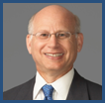
FTI CONSULTING, INC
GLOBAL INSURANCE INDUSTRY SERVICES
Practice Leaders
Richard Hershman, Senior Managing Director and Global Insurance Industry Practice Leader
Mr. Hershman is a CPA and has more than 35 years of professional experience in accounting, auditing, financial investigations, and complex financial matters involving financial reporting and the application of generally accepted accounting principles (GAAP) and statutory accounting principles. Mr. Hershman’s career includes assignments as executive vice president, chief financial officer and member of the board of a major insurance carrier and has been on the board and audit committee of several other insurance companies. In addition, he was an audit partner at one of the Big 8 accounting firms and an officer at one of the leading international investigations and intelligence firms.
Mr. Hershman’s experience includes:
Conducted investigations, including financial and operational review of the South Carolina Reinsurance Facility for the S.C. Senate Banking and Insurance Committee
Leading expert in critical insurance industry issues relating to reinsurance contracts, auditing procedures, and carrier solvency
Former CFO for company formed by The Zurich Insurance Group to administer the run-off of the Home Insurance Company
Former CFO for PSM Insurance Companies
Former engagement partner on insurance company financial audits
Richard Hershman
Senior Managing Director
3 Times Square
New York, NY 10036
(212) 499 3643
richard.hershman@fticonsulting.com

Slide 25
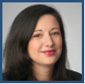
FTI CONSULTING, INC
GLOBAL INSURANCE INDUSTRY SERVICES
Practice Leaders
Wendy Shapss, Senior Managing Director, Global Insurance Industry Practice
Ms. Shapss is a CPA and has over 18 years experience in accounting, auditing, fraud and financial-based matters and specializes in litigation consulting, forensic accounting and fraud and financial investigations. Ms. Shapss has advised on cases involving lost profits, breach of contract claims, and accountants' malpractice. Her assignments have given her a broad range of industry experience. These industries include insurance, financial services, hospitality, automotive, waste management, publishing, and not-for-profit.
Ms. Shapss’ experience includes:
Involvement with an arbitrations which has included providing a binding conclusion regarding the appropriate audit steps for the testing of reinsurance contracts.
Reviewed and analyzed reinsurance invoices to determine their accuracy in connection with an arbitration matter.
Assisted counsel to a big four accounting firm in defending a litigation alleging misstatement of financial information leading to the liquidation of an insurance company.
Worked on various litigation matters involving internal controls surrounding revenue. recognition, allocation of expenses, reimbursement policies, recovery of rebates and credits, and reward programs.
Provided litigation assistance in defending an actuarial firm, where the insurance liquidator is claiming negligence against the actuarial firms.
Wendy Shapss
Senior Managing Director
3 Times Square
New York, NY 10036
(212) 841 9374
wendy.shapss@fticonsulting.com

Slide 26
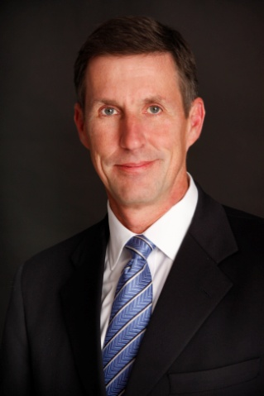
FTI CONSULTING, INC
GLOBAL INSURANCE INDUSTRY SERVICES
Practice Leaders
Paul Braithwaite, Senior Managing Director, Global Insurance Industry Practice
As a past President of the Casualty Actuarial Society with over 30 years of industry experience, Mr. Braithwaite offers deep knowledge and understanding of actuarial science, underwriting and insurance and reinsurance company management. He is an oft-requested speaker at industry events and conferences on topics including Solvency II, Capital Requirements and Capital Modeling, Reinsurance Risk-Transfer and Reinsurance Pricing. He has also published several articles on these topics.
Mr. Braithwaite’s consulting and industry experience includes:
Paul Braithwaite
Senior Managing Director
3 Times Square
New York, NY 10036
(212) 499 3659
Paul.braithwaite@fticonsulting.com
Extensive work with insurance companies, captives, self-insureds, brokers, and investment firms
Serving as an Appointed Actuary to insurance companies
Provision of expert testimony / dispute resolution support, loss reserve reviews, reinsurance commutations / reserve reviews, underwriting audits, due diligence, finite risk / structured product pricing analysis and regulatory services
Reinsurance pricing and underwriting consulting including the specialty areas of professional liability, workers compensation, umbrella liability, accident and health, agriculture, surety and various other lines of property-casualty business, including home and auto
Consulting on capital standards for life, health and property-casualty business
Acquisition advisory consulting for a major multi-line insurance group.
Chief Actuary as well as Senior Vice President & Chief Underwriting Officer for several global specialty business lines

Slide 27
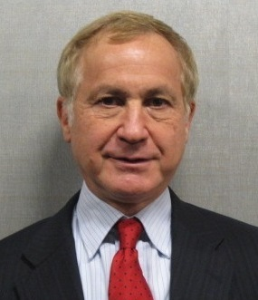
FTI CONSULTING, INC
GLOBAL INSURANCE INDUSTRY SERVICES
Team Leaders
Allan Kaufman is a member of FTI’s Global Insurance Services practice.
Allan Kaufman is a Fellow of the Casualty Actuarial Society with 30 years experience as a consulting actuary, 25 in the US and six in the UK. Mr. Kaufman has worked in the US, Europe and Asia on all types of casualty insurance actuarial consulting assignments including ratemaking and rating plans, merger and acquisition analyses, loss reserving, dynamic financial analysis, new product development, financial planning, risk assessment, and regulatory issues.
He has prepared written testimony and testified in depositions and in court and before regulators and legislative committees on a variety of insurance issues.
Allan’s clients have included multi-line primary and reinsurance companies, Lloyd’s syndicates and other London market reinsurers, and specialty companies in areas including workers compensation, medical malpractice, professional liability, health, title and warranty insurance.
Mr. Kaufman hold the professional designations of Fellow of the Casualty Actuarial Society, Member of the American Academy of Actuaries, Honorary Fellow of the Institute of Actuaries, Chartered Property and Casualty Underwriter, and Associate in Risk Management. He holds B.S. in Mathematics and Physics from Brooklyn College and an M.S. in Physics from University of Wisconsin.
Mr. Kaufman has participated on several advisory committees for the NAIC, the Casualty Actuarial Society, the American Academy of Actuaries, the International Actuarial Association, and the Institute of Actuaries (UK).
Allan Kaufman
3 Times Square
New York, NY 10036
Tel: (212) 841-9347
Fax: (212) 841-9350
26

Slide 28
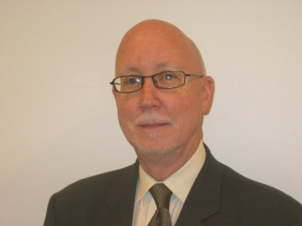
FTI CONSULTING, INC
GLOBAL INSURANCE INDUSTRY SERVICES
Team Leaders
Michael Flaharty is a member of FTI’s global insurance services practice.
Mr. Flaharty has more than 30 years of experience in insurance, reinsurance, and self-insurance focused on property and casualty. Mr. Flaharty’s diverse expertise includes management consulting, claims, operations, technology, strategic planning, merger and acquisitions, financial due diligence, runoff, and enterprise risk management (ERM).
Mr. Flaharty’s operations and technology experience includes the design and implementation of business process strategies and technology for claims handling, transaction environments, regulatory environments, document management systems, legal collaboration systems, and insurance pooling mechanisms.
The financial transaction experience of Mr. Flaharty includes due diligence (both M&A and divestiture) liability analysis, insurance program integration, carve-outs for major buy-sell activities, capital raising efforts, and post-acquisition integration, claim design, portfolio valuation and business redesign. Mr. Flaharty was also involved from a Risk Management perspective in the early formation of ACE and XL.
In runoffs, Mr. Flaharty led liquidation and runoff services for multiple voluntary and regulatory mandated runoffs; arranged support and placement of runoff operations in support of the acquisition of a multi state workers’ compensation insurer; and served as Conservator for a state controlled carrier in runoff.
Mr. Flaharty’s litigation support and expert testimony experience includes analysis and expert testimony on multiple major London and reinsurance litigation matters involving asbestos product liability and extended warranty; and subject matter expertise in defending against certification of class in a state wide action against a major automobile insurer.
Michael Flaharty
Managing Director
3 Times Square
New York, NY 10036
212. 651-7128
mike.flaharty@fticonsulting.com

Slide 29
FTI CONSULTING, INC
GLOBAL INSURANCE INDUSTRY SERVICES
Team Leaders
Mario Torsiello is a consultant working with FTI’s Global Insurance Services practice.
Mr. Torsiello is a CPA and an insurance investment banking expert, advising companies and regulators on mergers & acquisitions, financings, capital strategies, valuation, restructuring, private placements and other transactions. He has developed an in-depth knowledge of all forms of financings in the debt and equity markets. Positions include:
Mario Torsiello
Insurance Industry
Investment Banker
3 Times Square
New York, NY 10036
(646) 485 0534
mario.torsiello@fticonsulting.com
Torsiello Securities (and affiliates), as Founder, Sole Owner, President & CEO
Founder Director and Member of Executive Committee of Alterra, a 3.0 billion insurer/reinsurer based in Bermuda.
Dresdner Kleinwort Wasserstein, as a Managing Director & Head of the North American Insurance Practice
Citigroup (and its predecessors Salomon Brothers and Salomon Smith Barney) from 1986 to 1999, as Co-Head of the Insurance Practice from 1997 to 1999.
Insurance investment banking experience:
Co-manager of Allstate’s IPO
Sole manager of Farm Family’s demutualization and IPO
Co-manager of Allmerica Financial’s IPO
Co-advisor to Poe Financial Group
Director of and various advisory projects for CIBC Insurance Group
President & Director of INDC Group, a start-up internet provider of principally personal lines insurance products
Strategic advisor to BCS Insurance Group, a captive insurer to the Blue Cross Plans
Sole manager and board advisor in IPO/conversion of SCPIE, a reciprocal medical malpractice insurer
Various roles in demutualization-IPOs of Equitable Life, John Hancock, AmerUs Group, MONY Group and ISMIE
Initial placement agent and IPO co-manager for Max Capital in Bermuda
Various equity offerings and other transactions for Bermuda companies including PartnerRe, RenaissanceRe, Scottish Re and CIFG

